Slide 1
BRITISH AIRWAYS
PREDICTING CUSTOMER BUYING BEHAVIOUR
17-10-2024

Slide 2
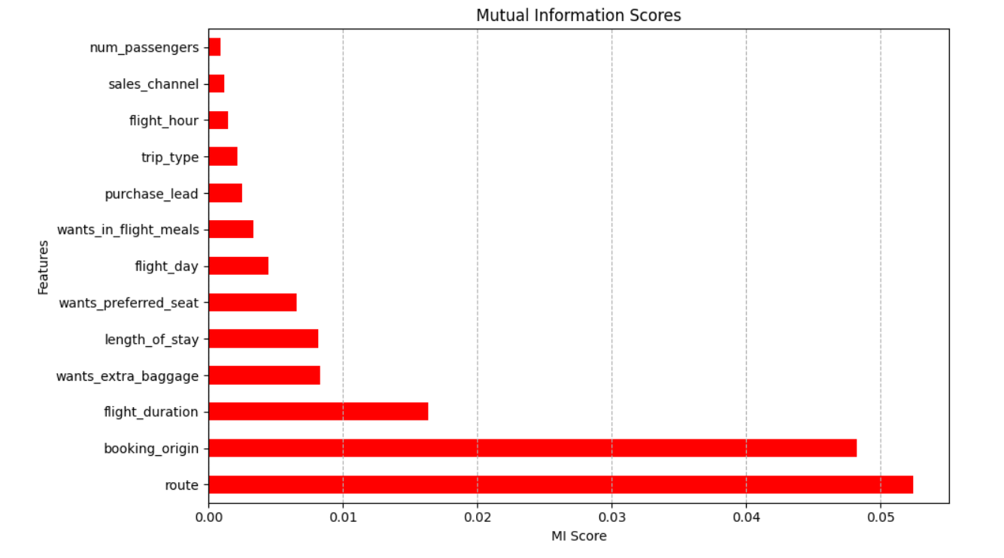
Predictive model to understand factors that influence buying behavior
We have trained the model with a
Random Forest Classifier and got an
accuracy of 84.76 and a AUC score of 0.547
The factors that influence the buying behaviour
the most are
route
booking_origin
flight_duration
wants_extra_baggage
length_of_stay

